Slide 1

CMR COLLEGE OF ENGINEERING & TECHNOLOGY
Kandlakoya, Medchal, Hyderabad - 501401
Department of Information Technology
VolumeWizard: Gesture-Driven Sound Mastery
Name of the student
Nadem Akshaya(21H51A1264)
Kashish Singhal(21H51A1247)
Under guidance of :
Mr.K.Venkateswara Rao
Associate Professor, HOD

Slide 2
Outline
Abstract
Introduction
Literature survey
Existing system
- Problems in existing system
Project Objective
Problem Definition
System Requirements
Proposed work
- Proposed system architecture
- Methods
- Comparison of Proposed system with an existing system
Performance Measure
Result Analysis of Existing System
Conclusion
Future Work
Notes:
2

Slide 3
Abstract
Notes:
3

Slide 4
ABSTRACT
In this project we are developing a volume controller and brightness adjustment in which we are using hand gestures as the input to control the system. Essentially, the OpenCV module utilized to manage the gestures in this implementation. This system primarily employs a web camera to record or capture images and videos, and this application regulates the system's volume/brightness based on the input. The primary purpose of the system is to change its volume and brightness. Python and OpenCV are both used to implement the project. To operate a computer's fundamental functions, such as volume control and brightness adjustment , we can use hand gestures. People won't have to acquire the typically burdensome machinelike abilities as a result. These hand gesture systems offer a modern, inventive, and natural means of nonverbal communication. These systems have many different applications in human interaction. This project's goal is to discuss a volume control/brightness control system based on hand gesture detection and hand gesture recognition. A high-resolution camera is used in this system to recognize the user's gestures as input. The primary objective of hand gesture recognition is to develop a system that can recognize human hand gestures and use that information to control a device. With real-time gesture recognition, a specific user can control a computer by making hand gestures in front of a system camera that is connected to a computer. With the aid of OpenCV and Python, we are creating a hand gesture volume control system in this project. This system allows for control without using a keyboard or mouse, controlled by hand gesture

Slide 5
INTRODUCTION
Notes:
5

Slide 6
Introduction
Gesture recognition technology is a significant aspect of human-computer interaction.
The project aims to develop a system enabling users to control device volume/brightness through hand gestures.
The envisioned outcome is a seamless and engaging means to adjust audio and brightness levels using intuitive hand movements.
Traditional methods, such as physical buttons and remote controls, are acknowledged for their limitations.
Gesture recognition technology, utilizing cameras or sensors, is presented as a promising solution to overcome these limitations.
The project focuses on leveraging advancements in computer vision and machine learning for interpreting and responding to hand gestures accurately.
Ultimately, the goal is to enhance user convenience, accessibility, and interaction with electronic devices in the digital era.
Notes:
6

Slide 7
Literature Survey
Notes:
7

Slide 8
Existing system
Classical interactions tools like keyboard, mouse, touchscreen and etc., may limit the way we use the system. All these systems require physical contact, in order to interact with system. Gestures can interpret same functionality without physically interacting with the interfacing devices.
Gesture Recognition using Accelerometer - The author has introduced an ANN application used for the classification and gesture recognition. Remote is basically used in this system as this remote rotate in the X, Y, Z direction. In order to decrease the cost and memory . After this the data is used for normalization using k means and Fast Fourier algorithm. Now, the recognition accuracy has increases up to 90%.
Notes:
8

Slide 9
Robust Part-Based Hand Gesture Recognition Using Kinect Sensor- In this author has used low cost cameras in order to make the things affordable for the users. A Kinect sensor is a sensor whose resolution is lower in comparison of other cameras but can detect and capture the big images and objects .To deal with the noisy hand gestures ,only fingers are matched with FEMD but not the whole hand . This system works perfectly and efficiently in uncontrolled environments. The accuracy of 93.2% is achieved with the experimental result.
Notes:
9

Slide 10
Project Objective
Notes:
10

Slide 11
Project objective
The objective is to provide a seamless and natural interaction method that enhances user experience in controlling audio output and screen brightness through hand gestures, ultimately contributing to the advancement of human-computer interaction technology.

Slide 12
Problem Definition
Notes:
12

Slide 13
Problem Definition
In the era of widespread computing, traditional user interaction tools like keyboards, mice, and pens may seem insufficient. Utilizing hands as a means of natural interaction is gaining prominence.
As artificial intelligence integrates further into daily activities, the interaction dynamics between computers and users evolve. Instead of relying on conventional button pressing, the aim is to employ gestures to seamlessly control volume/brightness, achieved through a straightforward Python program.
The primary focus of the project is to establish a robust and precise system for recognizing and tracking hand gestures using Python.

Slide 14
System Requirements
Notes:
14

Slide 15
Software Requirements
LIBRARY | VERSION | INSTALLATION COMMAND
Python | 3.11.2 | Download Python
OpenCV(cv2) | 4.8.1.78 | pip install opencv-python
Media Pipe | 0.10.8 | pip install mediapipe
ctypes | 1.2.0 | pip install comtypes
NumPy | 1.26.2 | pip install numpy
SpeechRecognition | 3.10.1 | pip install SpeechRecognition
screen_brightness_control | 0.22.1 | pip install screen-brightness-control
Pycaw | 20230407 | pip install pycaw

Slide 16
Hardware Requirements
HARDWARE | VERSION/SIZE/CAPACITY | REQUIREMENTS
Camera | 2023.2311.5.0 | Webcam with good resolution and frame rate
System Microphone | 6.0.9049.1 | Clear audio capture capabilities
Monitor | LCD/LED | Sufficient processing power for real time operation
System Speakers | 6.0.9049.1 | Device for playing audio with adjusted volume

Slide 17
Proposed Work
Notes:
17

Slide 18
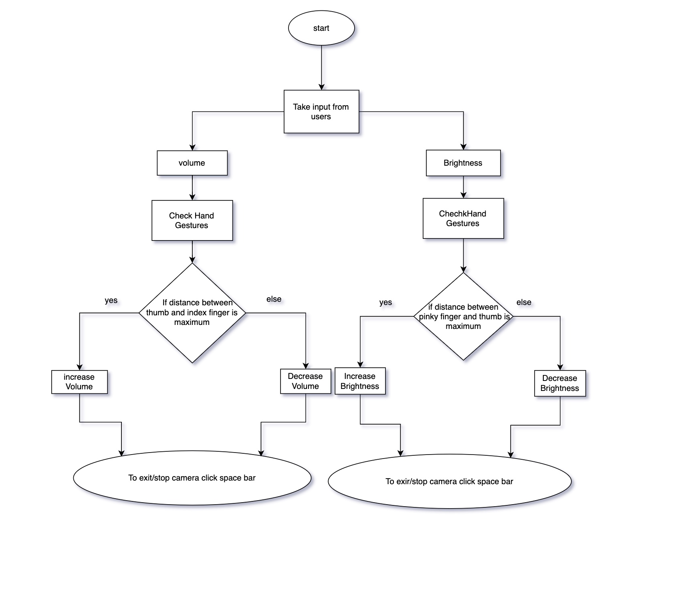
Proposed system architecture
Fig : System Architecture

Slide 19
Proposed Methods
The described methodology outlines a Python program for hands-free volume and brightness control using a combination of voice commands and hand gestures. Upon receiving a voice command such as "volume" or "brightness," the program utilizes the Media Pipe library to capture and analyze images of the user's hand gestures through a camera dialog box. The Media Pipe library identifies specific hand landmarks, like the gap between the thumb and index finger for volume control or the distance between the pinky finger and thumb for brightness adjustment. The program calculates distances between these landmarks, representing volume or brightness ranges, and provides visual feedback to the user through a displayed bar. As the user adjusts the gap between fingers, the volume or brightness dynamically changes. This interactive process continues until the user stops or terminates the program, offering an intuitive and engaging hands-free control experience.
The volume calculation formula in our code uses the Euclidean distance between the tips of the thumb and index finger. The formula, length = hypot(x2 - x1, y2 - y1), calculates this distance. The np.interp function then performs linear interpolation, mapping the calculated distance to a volume level within the specified range [vol_min, vol_max].

Slide 20
Proposed Methods
The distance range [30, 350] corresponds to the expected thumb-to-index-finger distance, ensuring proportional volume adjustments. The vol variable represents the adjusted volume level, with vol_min and vol_max indicating the minimum and maximum supported volume levels by the audio system. The brightness calculation in the code relies on the Euclidean distance between the thumb and pinky finger. The function calculate_distance computes this distance, and the subsequent line adjusts brightness based on the calculated distance. The adjustment value, obtained by subtracting 50 from the distance and dividing by 10 for scaling, determines the brightness change. The current brightness is extracted using get_brightness(display=0)[0], and the new brightness is constrained within the valid range of 0 to 100 using max(0, min(100, current_brightness + brightness_change)). Finally, the set_brightness(new_brightness, display=0) function applies the new brightness level to the display.

Slide 21
Performance Measure:
The performance of a volume control system using hand gestures can be assessed through various measures. Here are some key performance metrics:
Accuracy: Measure the accuracy of the system in recognizing and correctly interpreting hand gestures for volume adjustments. This involves assessing the system's ability to distinguish between different gestures accurately.
Accuracy=Number of Correct Gesture Recognition/ Total Number of Gesture Recognition ​×100%
=14/15*100
=93.3%
Precision: In the context of volume control using hand gestures, Precision would assess how many of the recognized gesture for volume adjustment were correct.
Precision=True Positives/(True Positives +False Positives)

Slide 22
Result Analysis of Existing Project:
Study | Technology used | Cost Consideration | Recognition Accuracy | Limitations
Gesture Recognition using Accelerometer | Accelerometer in remote | Decrease cost and memory, Remote for affordability | 90% increase in recognition accuracy | Need of separate device to operate
Robust Part-Based Hand Gesture Recognition Using Kinect Sensor | Kinect sensor with lower resolution | Low-cost cameras for affordability | 93.2% accuracy based on experimental results | Need of separate device or sensor to operate which is difficult

Slide 23
Conclusion:
The model is designed to be user-friendly and interactive, streamlining tasks and supporting multiple functions.
The system is cost-effective, running on standard camera-equipped PCs, enabling real-time vision-based hand gesture recognition.
Utilizing natural hand gestures, the system facilitates real-time control over volume through the Gesture desktop-based system.
Extending its capabilities, the system includes hand-controlled screen brightness, allowing precise positioning using the hand alone.
A straightforward probabilistic model is integrated to enhance system reliability, preventing responses to inaccurate gestures.
Emphasis on an innovative mechanism highlights the use of natural hand gestures for real-time volume and pointer navigation control.

Slide 24
Future Work:
The current system is limited by the quality of the input images, and sometimes fails to detect the correct gesture due to variations in lighting, hand orientation, and other factors. To address this issue, future research can explore the use of advanced computer vision techniques such as deep learning algorithms to improve the accuracy and robustness of the system.
Expanding the system to recognize a broader range of complex gestures, beyond volume control, is another potential area for development. Machine learning techniques could enable recognition of gestures like pointing, waving, or grabbing for more natural interaction.
Enhancing audio control capabilities to include specific adjustments for bass and treble would provide users with a more personalized audio experience

Slide 25
References
Tiwari, S., Yadav, A. L., Mishra, A., & Kukreja, D. Volume Controller using Hand Gestures.
https://www.researchgate.net/profile/Anup-Lal-Yadav/publication/374504401_Volume_Controller_using_Hand_Gestures/links/65204415b0df2f20a2164090/Volume-Controller-using-Hand-Gestures.pdf
Nidhishree Arun, Namratha V , Ananya Dutta , Shreenivas B. Hand Gesture Recognition and Volume Control.
https://ijcrt.org/papers/IJCRT22A6059.pdf
Martendra Pratap Singh, Arzoo Poswal, Eshu Yadav Volume Control using Gestures
https://ijisrt.com/assets/upload/files/IJISRT22MAY250_(1).pdf

Slide 26
Aaditya Meshram, Chaitanya Thakre, Chandrabhan Rahangdale, Sagar Chouksey, Swaroop Bhoyar, Prof. Pragati Patil Volume, Brightness and Curser Controller with Hand Gesture (5), 2023
Anukriti Rajput, Uttkarsh Sharma, Ashok Kumar Volume Controlled by Hand Gesture Recognition. 12(Special Issue 5),2023
Mr.V.Balu, Elamarthy Venkata Vyshnavi, Dondapati Devi Priyanka VOLUME CONTROL USING HAND GESTURES (6),2022
Prof.P Ajitha, Irfan Ahmed M N, Mohith Seshan K M, Siva C Gesture Volume Control (11),2022

Slide 27
Thank You!

